Slide 1





Final Project Web Programming

Slide 2


Members (E.D.I.T.H):
Nguyễn Xuân Nam - 17110056
Đinh Quốc Thuỵ - 17110081

Slide 3



1. Project Overview
Overview
Required Tools
Goal

Slide 4
Overview
The project is the kind of software management system of university include student, instructor, course, etc. table. This project will let you know :
How to create a basic web application using MVC ( Model – View – Controller)
CRUD method
How client-server work ?

Slide 5
Required tools
Framework : ASP.NET Core, Jquery , Bootstrap
Languages : C#, HTML, CSS

Slide 6
Goal
Finished the project
By using MVC model and CRUD method, our team have created tables with functions :
Student ( Create/Edit/Details/Delete )
Instructor ( Create/Select/Edit/Details/Delete)
Course(Create/Edit/Details/Delete)
Department(Create/Edit/Details/Delete)
Enrollment (Create/Edit/Details/Delete)
CourseAssignement(Create/Edit/Details/Delete)
The project have user management and user authentication by using ASP.NET Core Identity to create a login and register form
The project can access related data from one table to another table
Notes:
Asp.net core identity is a membership system. It allow us to read, create, update and delete user accounts . Support account confirmation, authentication, authorization, password recovery, two-factor authentication with SMS. It also supports external login providers like Microsoft, Google or Facebook

Slide 7
2. UseCase

Slide 8
Login
Feature Name | Login
Description | A user login to System to access the functionality of the system.
Actors | Admin, Users
Pre-Condition | System must be connected to the network.
Post -Condition | After a successful login → return redirectly to public page

Slide 9
Register
Feature Name | Register
Description | A user must go to register after login to System to access the functionality of the system if user don’t have an account
Actors | Users,Admin
Pre-Condition | System must be connected to the network.
Post -Condition | After a succesfull register → return redirectly to login

Slide 10
Create
Feature Name | Create
Description | Create new information for all table in database
Actors | Admin.
Pre-Condition | Only availaible when user login as Admin account
Post -Condition | After a successful login → A create link will show up for admin

Slide 11
Edit
Feature Name | Edit
Description | Edit information data that already have in database before
Actors | Admin, Users
Pre-Condition | Actors must be logged in login form first.
Post -Condition | After a successful login → Edit link will show up

Slide 12
Details
Feature Name | Login
Description | View information data of each table in database, include related access data from one table to another table
Actors | User, Admin
Pre-Condition | Actors must be logged in Login form first. If user don’t have an account, redirect return to Register form
Post -Condition | After a successful login → Details link will show up

Slide 13
Delete
Feature Name | Delete
Description | Delete information data of table from database.
Actors | Admin
Pre-Condition | Actor must have logged in Login form as Admin account .If actor not an admin, they won’t have permission to delete
Post -Condition | After a successful login → Delete link will show up

Slide 14
Select
Feature Name | Select
Description | Select a course for instructor to teach in Instructor View
Actors | Admin
Pre-Condition | Actor must have logged in Login form as Admin account .If actor not an admin, they won’t have permission to delete
Post -Condition | After a successful login → Select link will show up

Slide 15
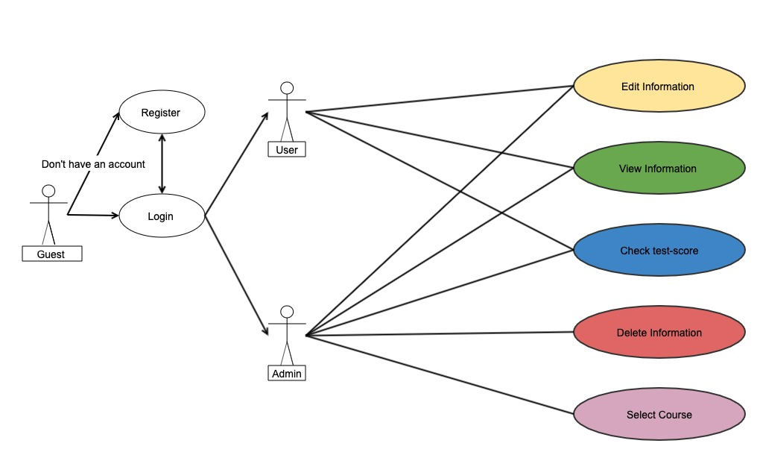
Usecase diagram for user and admin

Slide 16
3. Class Diagram
UTE University System class diagram
ASP.NET Core class diagram

Slide 17
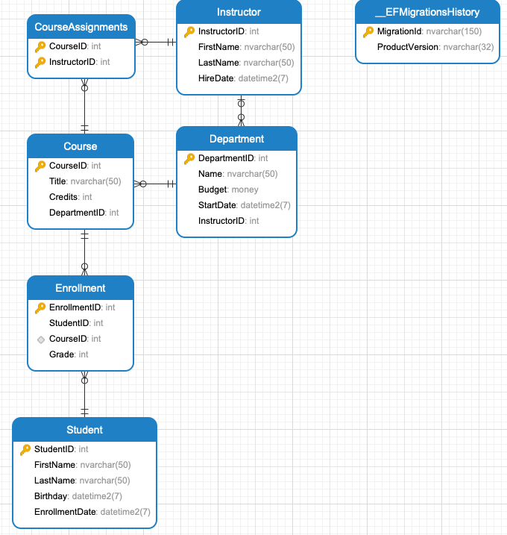
UTE University System Class Diagram

Slide 18
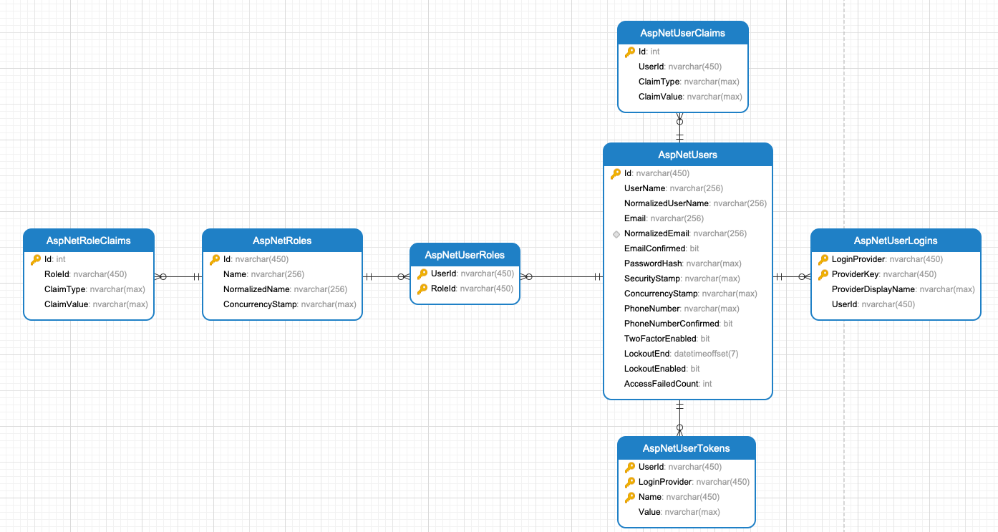
ASP.NET Core Identity class diagram

Slide 19
3. ERD ( Entity-Relationship-Diagram)

Slide 20
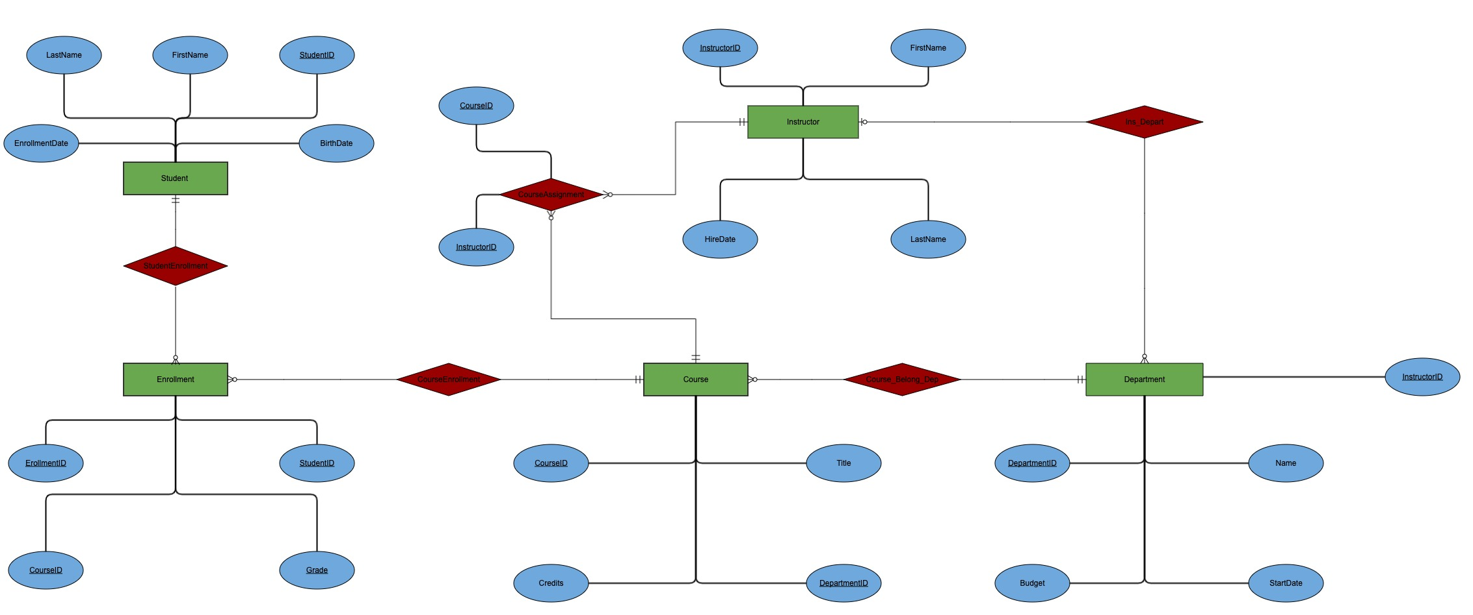

Slide 21
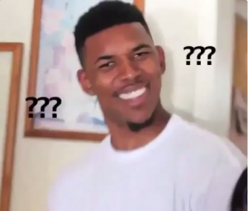

Thanks!
Any questions?

